Slide 1
Customer Segmentation Shopping Trends
Client Project : Customer Segmentation (project_shopping_trends)
Project Id: CDACL002 - Customer Segmentation
Project Team Id.: PTID-CDA-AUG-25-661
Date: 20/12/2025.
- By Onkar Jhingade, Nimish Bibave , Mayur Mate.

Slide 2
Introduction :
Customer Segmentation: is a data analytics technique for unlocking Shopping Insights.
This dataset encompasses various features related to customer shopping preferences, gathering essential information for businesses seeking to enhance their understanding of their customer base.
The features and interactions with promotional offers is included.
With a collection of 3900 records, this dataset is a foundation for businesses looking to apply data-driven insights for better decision-making and customer-centric strategies.

Slide 3
Objectives :
The objective of this customer segmentation is:
To analyze customer purchasing behavior and trends.
To segment customers into meaningful clusters based on their shopping patterns.
To identify high-value and low-engagement customer groups.
To provide data-driven insights for targeted marketing strategies. Business Goal:
Enable shoppers (U.S. market) to optimize promotions, improve customer experience, and increase revenue through customer segmentation.

Slide 4
Attribute Information :
Customer ID - Unique identifier for each customer
Age - Age of the customer
Gender - Gender of the customer (Male/Female)
Item Purchased - The item purchased by the customer
Category - Category of the item purchased
Purchase Amount (USD) - The amount of the purchase in USD
Location - Location where the purchase was made
Size - Size of the purchased item
Color - Color of the purchased item

Slide 5
Attribute Information :
Season - Season during which the purchase was made
Review Rating - Rating given by the customer for the purchased item
Subscription Status - Indicates if the customer has a subscription (Yes/No)
Discount Applied - Indicates if a discount was applied to the purchase (Yes/No)
Promo Code Used - Indicates if a promo code was used for the purchase (Yes/No)
Payment Method - Customer's most preferred payment method
Frequency of Purchases - Frequency at which the customer makes purchases (e.g., Weekly, Fortnightly, Monthly)

Slide 6
Tools & Technologies Used:
MySQL Workbench
Python (Pandas, NumPy, Scikit-learn, Matplotlib, Seaborn)
Jupyter Notebook
Microsoft PowerPoint

Slide 7
Methodology :
DataBase: project shopping trends (Table Name: shopping_table)
Steps Performed :
Database connection from given credentials.
Data Collection: Dataset was exported from MySQL database into CSV format, Loaded into Python using Pandas library by using Jupyter Notebook.
Data Preprocessing: Handled missing values Selected relevant numerical features Applied Standard Scaler for feature normalization.

Slide 8
Methodology :
Steps Performed :
4. Exploratory Data Analysis (EDA) : Analyzed customer age distribution Studied spending patterns and purchase frequency Identified trends across product categories and seasons
5. Customer Segmentation: Applied K-Means Clustering algorithm Features used:
Age
Purchase Amount
Review Rating
Previous Purchases
6. Insights & Interpretation: Identified high-value customers
Detected frequent and loyal shoppers
Recognized low-engagement customer segments

Slide 9
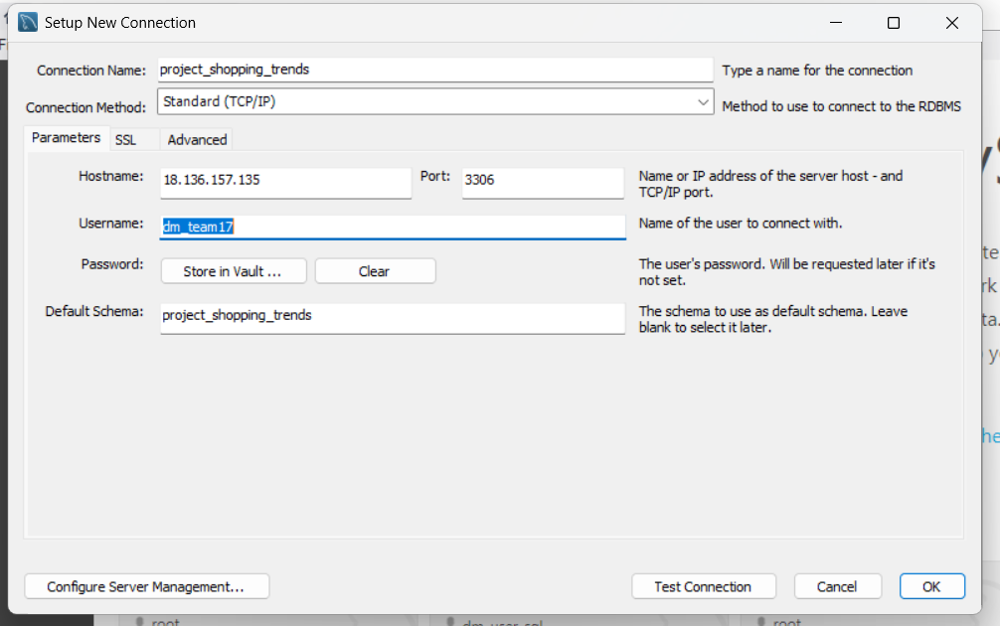
Database connection :
Connect the database with MySQL Workbench using the credentials provided.

Slide 10
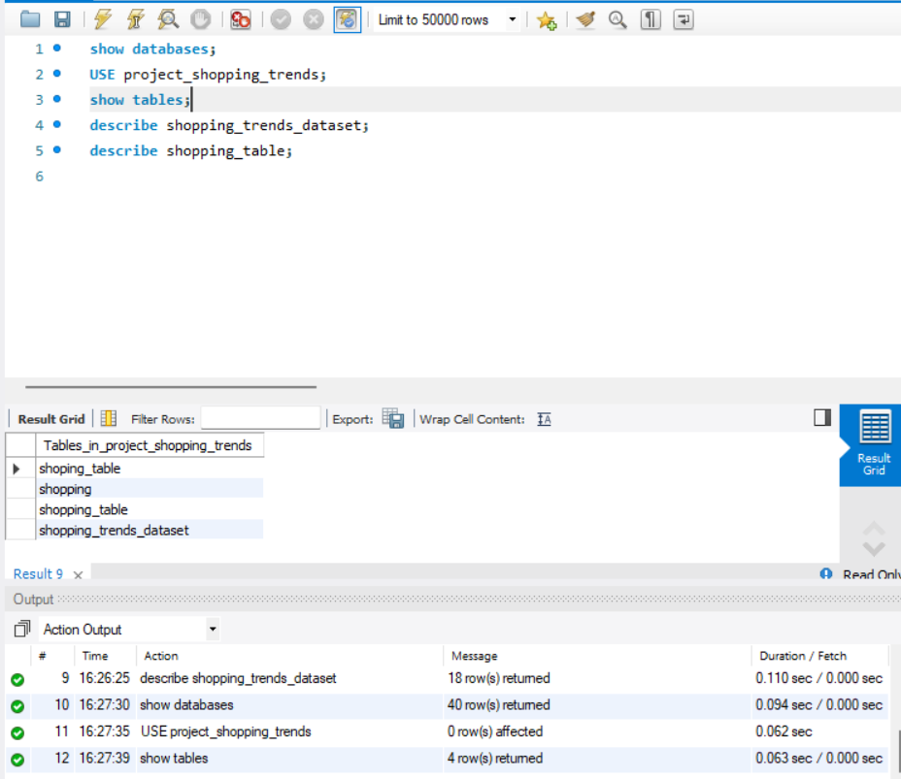
Now using SQL Query (select * from shopping_table) get the data.

Slide 11
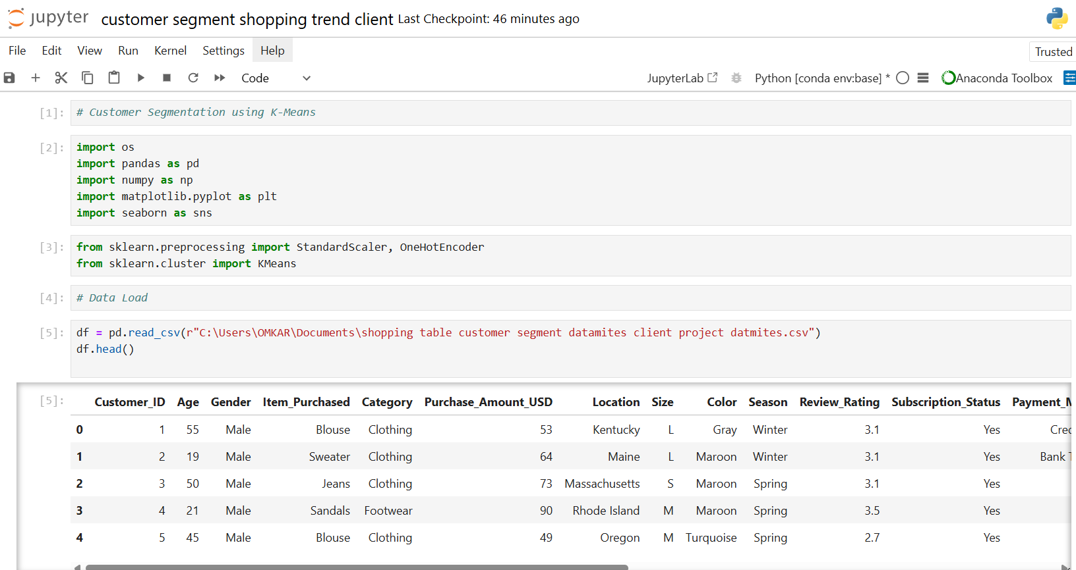
STEP 1: Data Load And Check :
By Using Jupyter Notebook first imports done OS, Libraries and then load data by proper path.

Slide 12
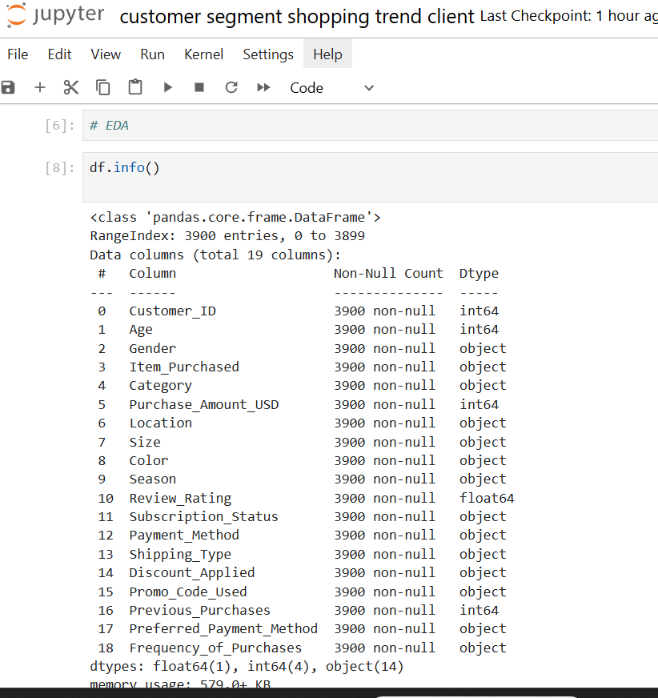
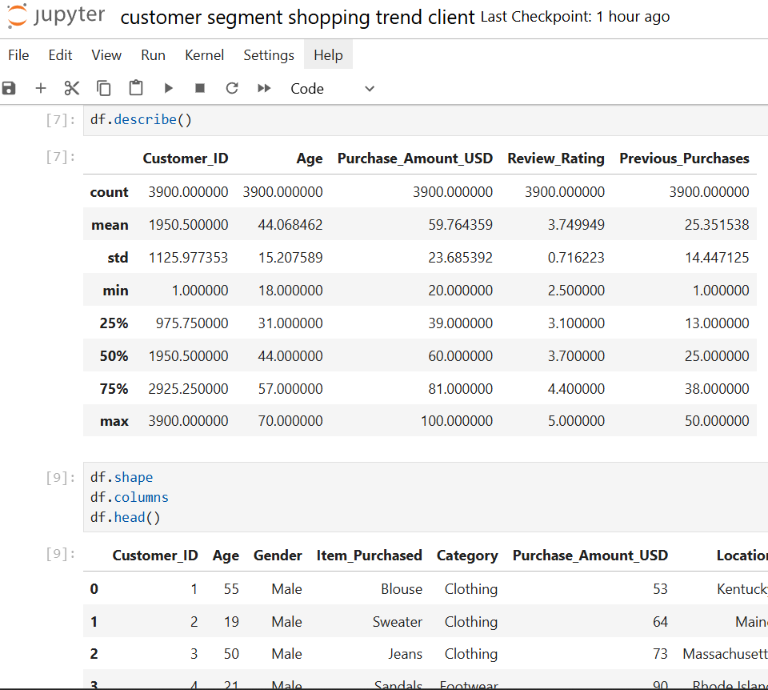
EDA :

Slide 13
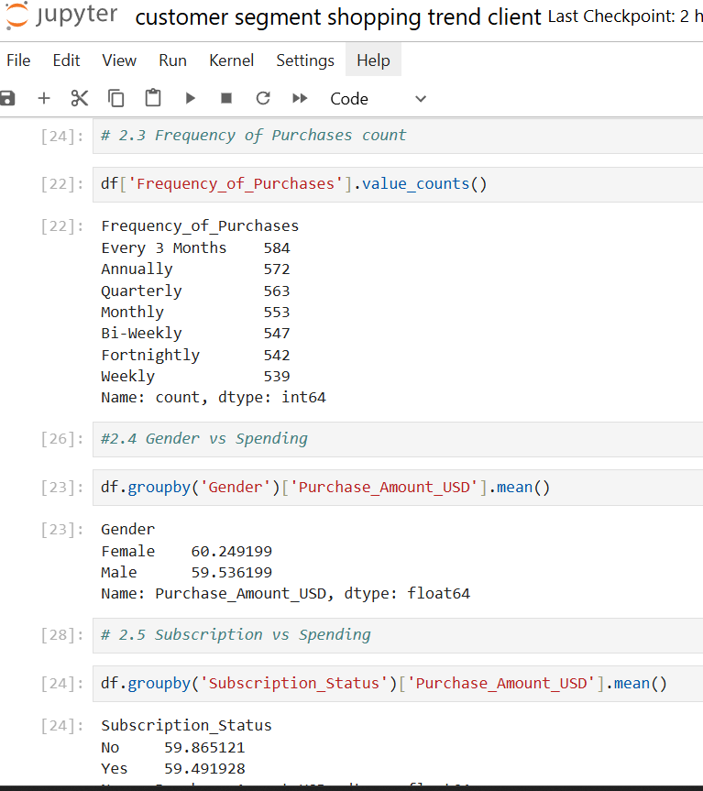
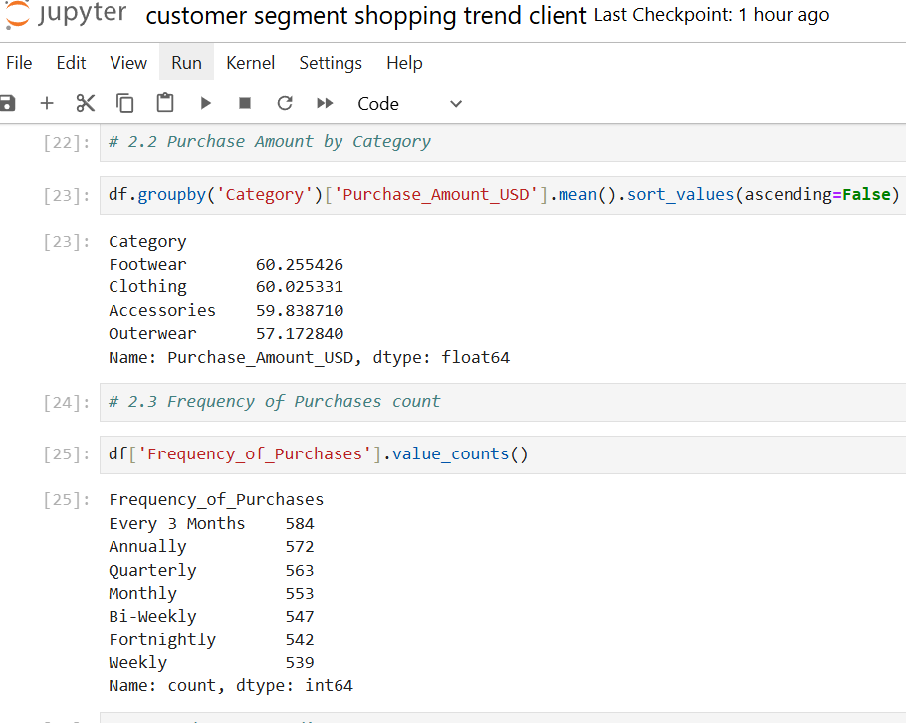
Purchase Amount by Category, Frequency of Purchases count and Gender vs Spending & Subscription vs Spending

Slide 14
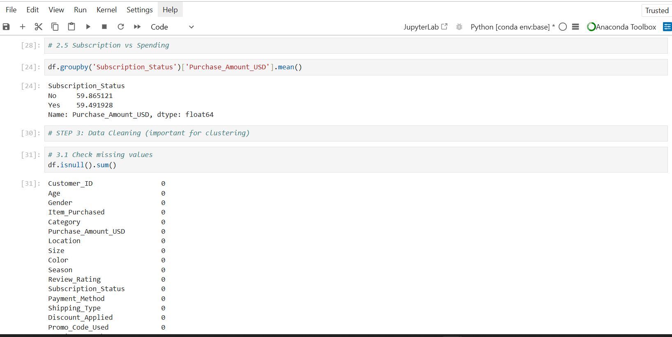
Subscription vs Spending and missing values:

Slide 15
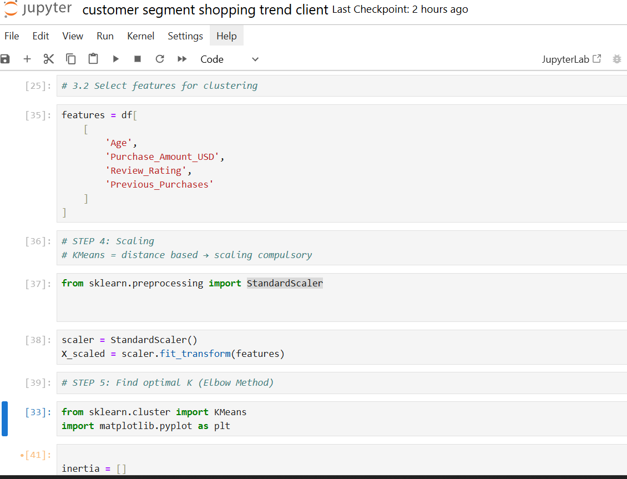
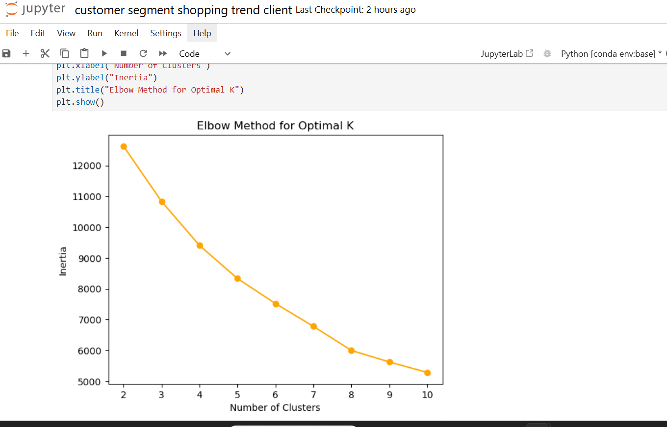
Select features for clustering, Scaling and Elbo method for optimal K plot: ‘Number of Clusters’ Vs ‘Inertia’

Slide 16
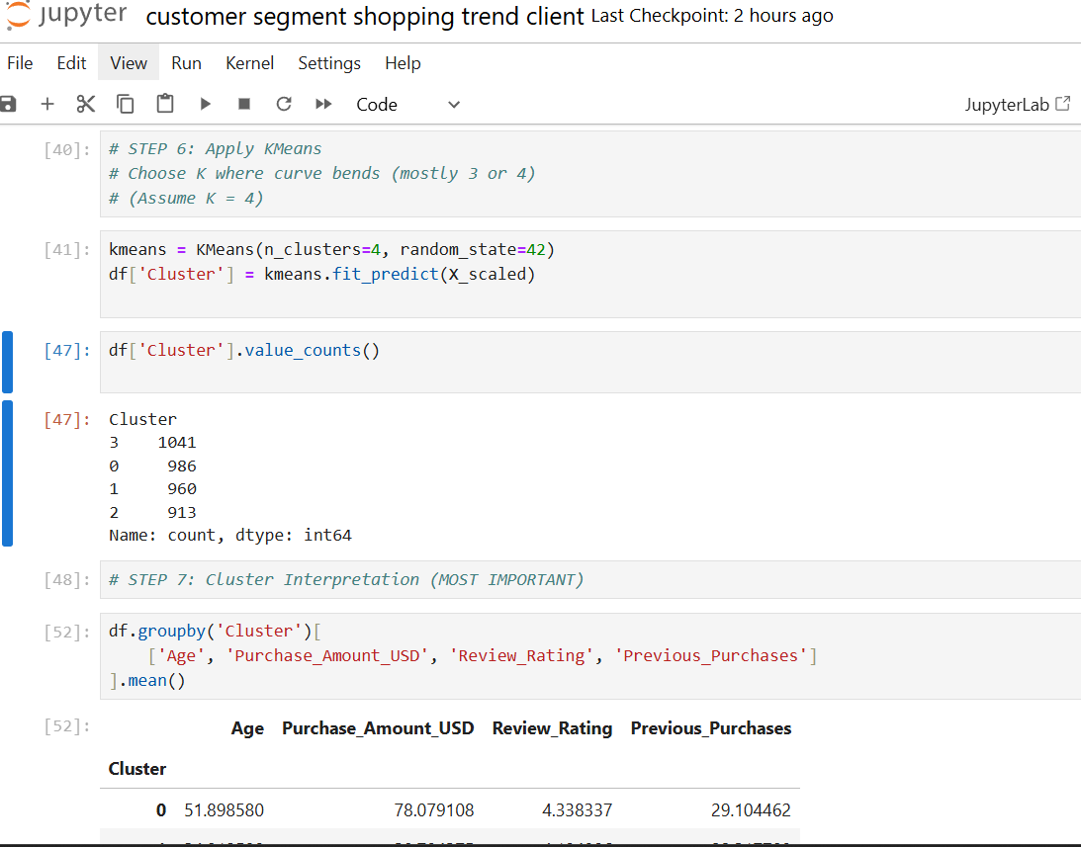
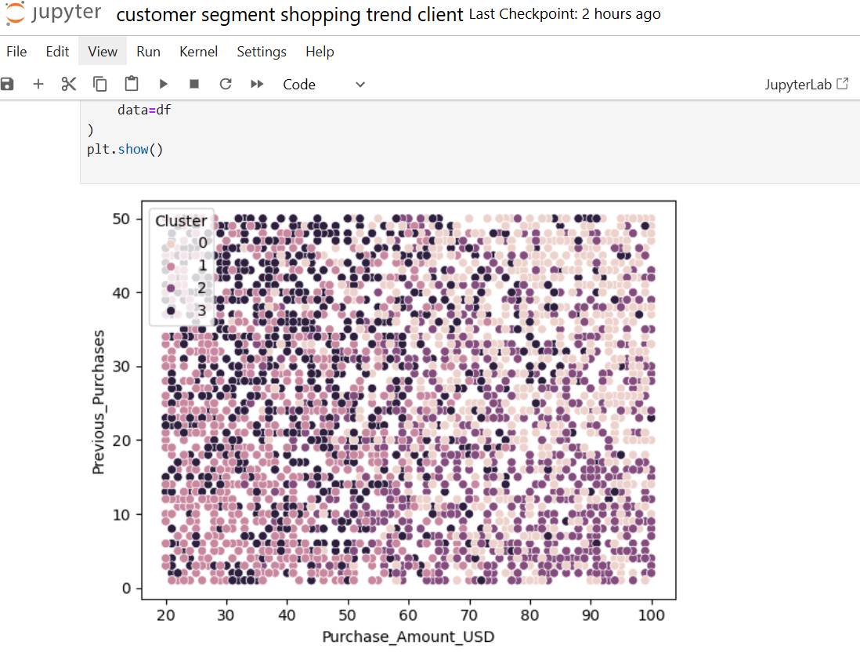
Apply K-means and Visualization Cluster for ‘Purchase_Amount_USD’ Vs ‘Previous_Purchases’

Slide 17
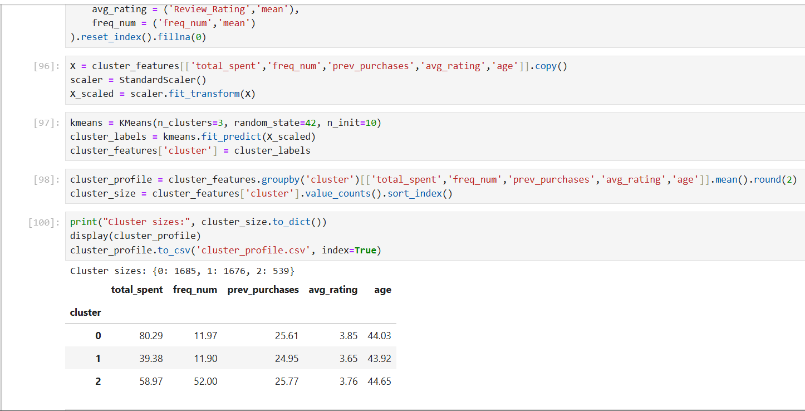
Clustering (3 groups) + cluster profiling + dominant factors by using K-means

Slide 18
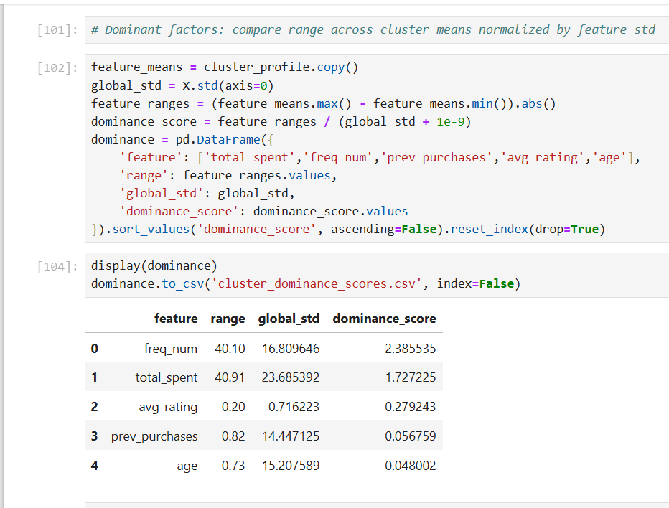
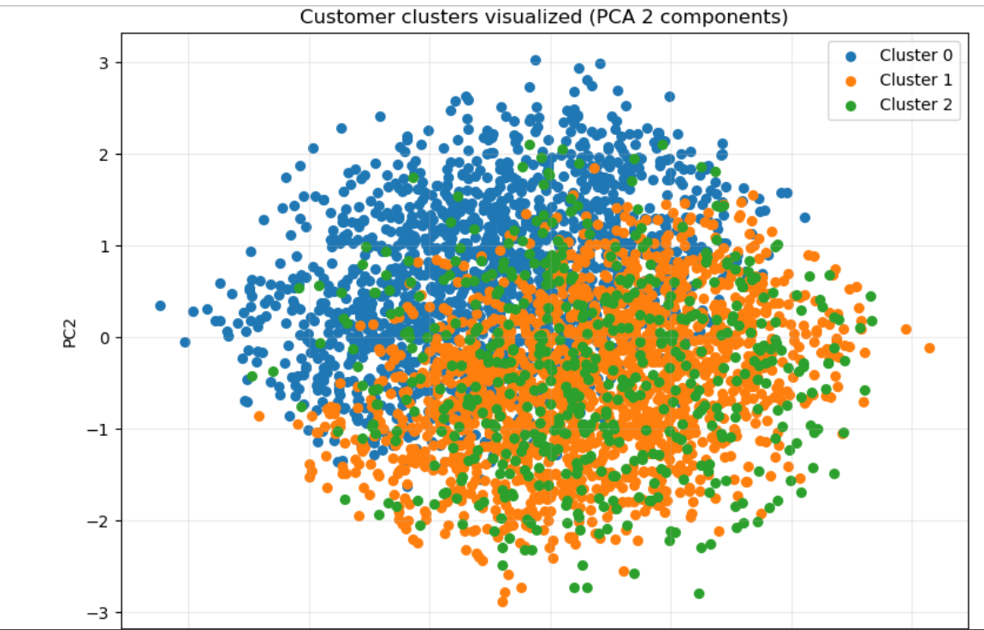
2D PCA scatter for visualization# Generated 3 clusters and the dominance table highlights which features differentiate the clusters the most# (i.e., the dominant factors)

Slide 19
Cluster interpretation (sample)
Cluster | Trend Summary
Cluster 0 | High spenders, frequent buyers
Cluster 1 | Young, low spend, less loyal
Cluster 2 | Loyal customers, high repeat purchases
Cluster 3 | Moderate spenders, good satisfaction
Category selection for discounts:
categories in low_spend_low_rating table are prime candidates for either product quality review or targeted discounts to boost conversion.
If a category already has very high discount_rate, discounts may be saturated — check promo_rate vs avg_spend.
2. Card spending by age:
Young (18-30) shows high card_spend_share_pct.
3. Season & Location:
season_card shows seasons with highest card spend; plan seasonal card offers then.
loc_card shows locations where card share is highest — target location-specific bank tie-ups.

Slide 20
4. Clustering outcomes & dominant factors:
cluster_profile.csv gives profiles (e.g., cluster with very high total_spent = high-value customers).
cluster_dominance_scores.csv ranks which features most differentiate clusters (likely total_spent, freq_num, prev_purchases, avg_rating).
“identified different customer segments such as high spenders, frequent buyers, and price-sensitive customers.”
“For example, some customers had high purchase value but low frequency, while others were frequent buyers but depended on discounts.”

Slide 21
Cluster-wise Insights:
1: High-Value Loyal Customers: High purchase amount and frequent shopping High review ratings Regular use of subscriptions and promo codes
2: Budget-Conscious Frequent Shoppers: Medium purchase amount Frequent purchases with discounts Sensitive to promotions and offers
3: Low-Engagement Occasional Customers Low purchase frequency Lower spending and mixed ratings Minimal interaction with offers

Slide 22
Conclusion:
Incorporated data analysis techniques
Customer segmentation helped identify distinct shopping behaviors.
K-Means clustering effectively grouped customers based on trends.
Data-driven insights enable targeted marketing and better customer retention.
MySQL doc: https://docs.google.com/document/d/1r7Dek8o6tCkwXAh4YS2mtwsmNS0TTwR0EHHFdGQJPhU/edit?usp=sharing Record Video link: https://www.loom.com/share/df52575117424b159435342114ea11f4

Slide 23
Thank You

